Slide 1


Sarvajanik Education Society Sarvajanik College of Engineering & Technology, Surat. Master of Computer Applications Academic Year: 2024– 25
A Project On
“Hospital Management System”
Presented By
Ghelani Isha (ET24MTCA016)
Italiya Avi (ET24MTCA018)
Moradiya Chetali (ET24MTCA033)
Sheta Shubham (ET24MTCA062)
MCA SEM-1
Under the Guidance of
Prof. Preksha Parmar

Slide 2
AGENDA
Abstract
Objective
System Description (Technologies Used)
Database Design/ File System (Table Designs)
Diagrams (Use Case Diagram, Activity Diagram)
Screen Shots
Limitation
References

Slide 3
ABSTRACT
This project involves the development of a Hospital Management System using the C programming language. The system is designed to manage a small Hospital that includes a general clinic, as well as Hospital for Heart, Lung, and Plastic Surgery. Patients can be added to the system in any order and then assigned to a designated Hospital. The system also includes an Urgent Department when patients can be added and immediately sent to the appropriate department based on their medical requirements without delay. This straightforward and efficient system helps Hospital administrators to manage patient flow and optimize medical care services.

Slide 4
OBJECTIVE
The system should computerize patient and Hospital details, including records of Patients, Doctors and Receptionists.
The system should keep Patient information up to date.
The system should allow Doctors and other Staff to perform efficiently.
The system should keep records of Patient Diseases, Diagnosis and Management.
The system should keep records of the Hospital’s Employees.
Maintain data persistently using a File-based approach for Patient, Doctor and Receptionists records.

Slide 5
SYSTEM DESCRIPTION (TECHNOLOGY USED)
Operating system | Windows10
software | Dev C++
Ram | 8 GB
Hard Disk | 512 GB
Processor | Intel i5 11th Generation

Slide 6
DATABASE DESIGN/ FILE SYSTEM (TABLE DESIGNS)
The System uses Three text files to store data.
1. patients.txt
Data Member | Data Type | Description
Id | int | Unique identifier for the Patient
Date | char[15] | Date of the Patient Add
Name | char[50] | Name of the Patient
Age | int | Age of the Patient
Disease | char[50] | Disease of the Patient
Address | char[100] | Address if the Patient
Mobile no | int | Mobile no of the Patient
Gender | char[10] | Gender of the Patient
Username | char[50] | Username of the Patient
Password | char[50] | Password for the Patient

Slide 7
2. doctors.txt:
3. receptionists.txt:
Data member | Data type | Description
Id | int | Unique identifier of the Doctor
Name | char[50] | Name of the Doctor
Speciality | char[50] | Speciality of the Doctor
Username | char[50] | Username of the Doctor
Password | char[50] | Password for the Doctor
Data member | Data type | Description
Id | int | Unique identifier of the Receptionist
Name | char[50] | Name of the Receptionist
Username | char[50] | Username of the Receptionist
Password | char[50] | Password for the Receptionist

Slide 8
DIAGRAMS (USE CASE DIAGRAM, ACTIVITY DIAGRAM)
Use Case Diagrams
ADMIN:
Login
Manage Patient
Manage Doctor
Manage Receptionist
Logout

Slide 9
RECEPTIONIST:
Login
Manage Patient
Logout

Slide 10
DOCTOR:
Login
View Patient Records
View Profile
Logout

Slide 11
PATIENT:
Login
View Profile
Logout

Slide 12
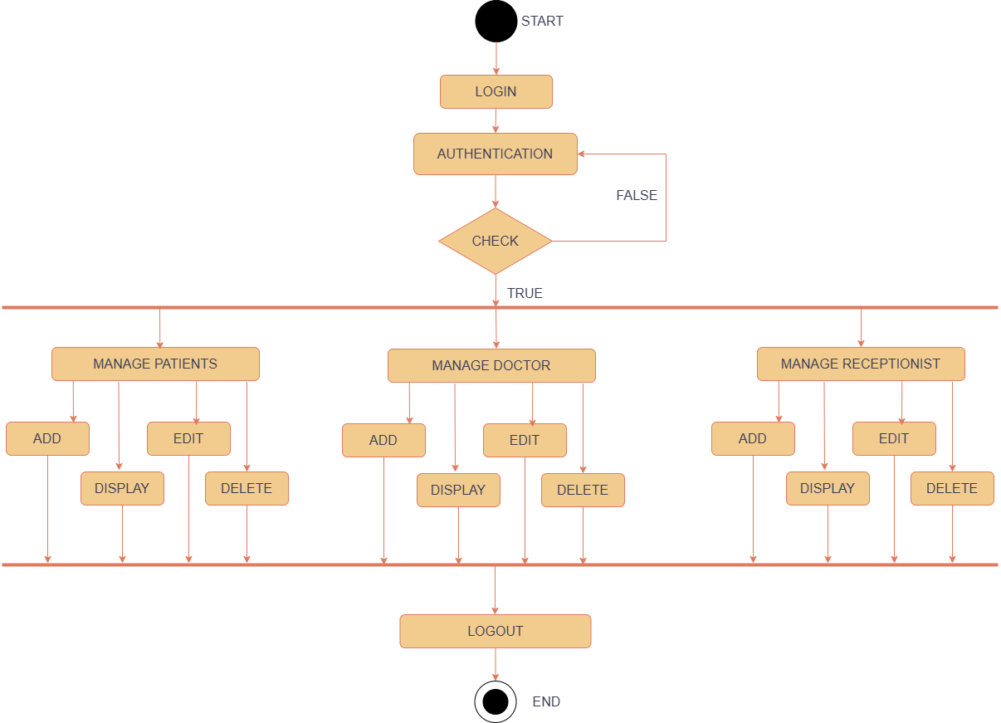
Activity Diagrams (Admin)

Slide 13
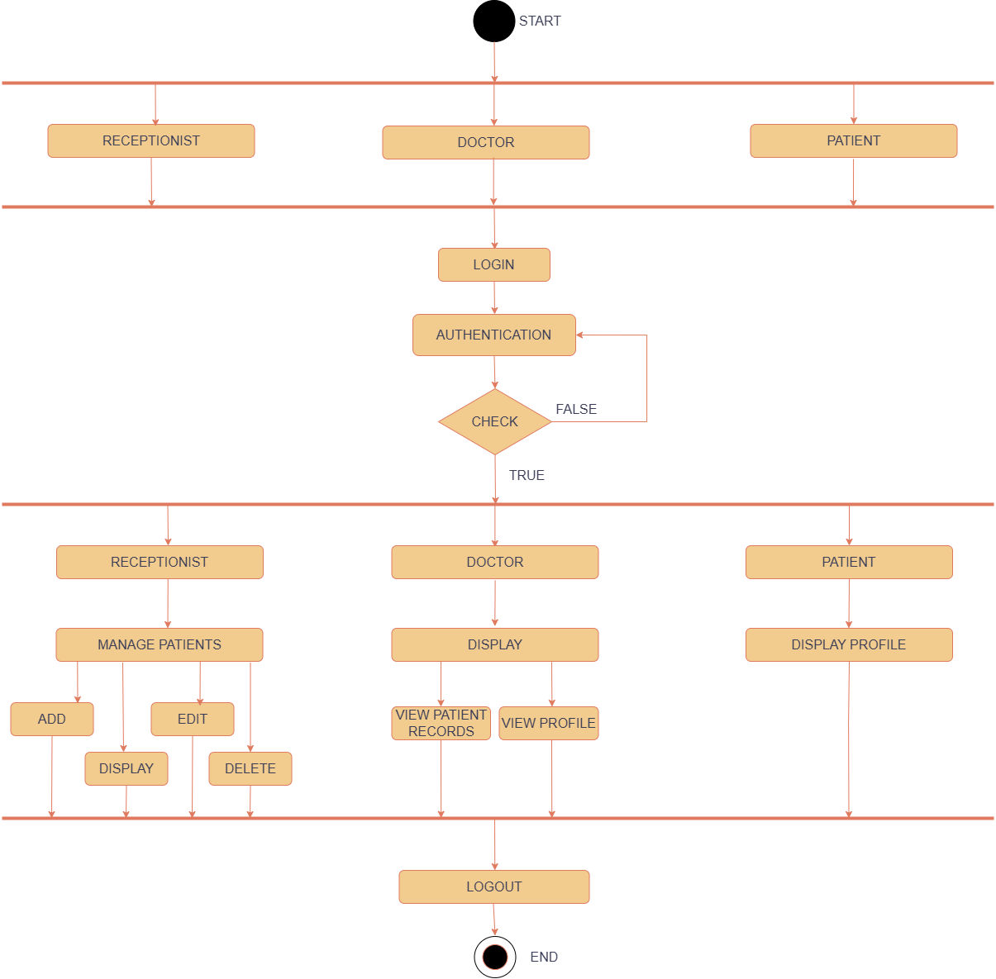
Activity Diagrams (User)

Slide 14
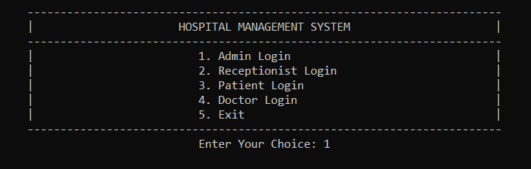
SCREEN SHOTS Login

Slide 15
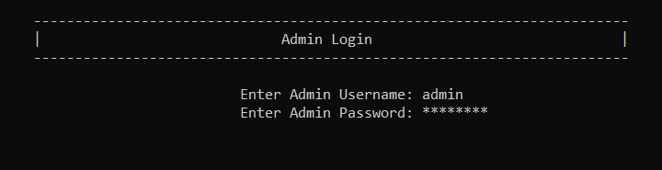
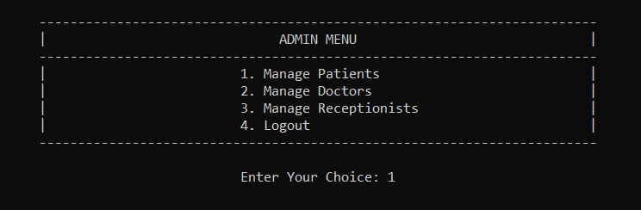
Admin Login

Slide 16
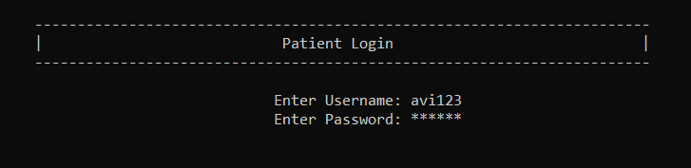
Patient Login

Slide 17
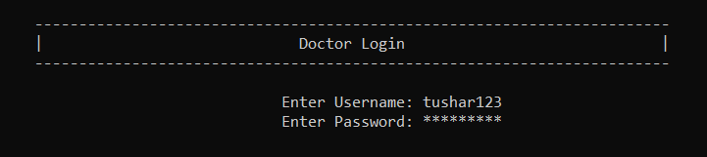
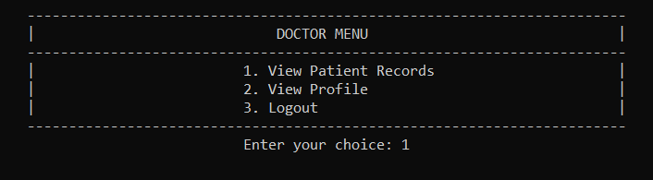
Doctor Login

Slide 18
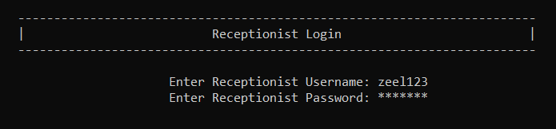
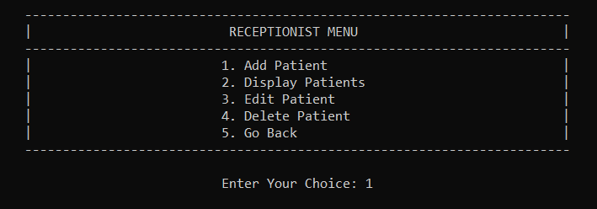
Receptionist Login

Slide 19
LIMITATION
Hospital management System could not provide all the Department of a Hospital due to the short time periods.
The admin and receptionist login systems store passwords in plain text in the files. This makes the system vulnerable to unauthorized access.

Slide 20
REFERENCES
https://www.youtube.com/watch?v=ggLvWc1v7WA
https://www.slideshare.net/slideshow/hospital-management-final-report-presentation/64370810
Project Source Code and Implementation: Refer to the provided hospital.c file.

Slide 21
THANK YOU

